Slide 1

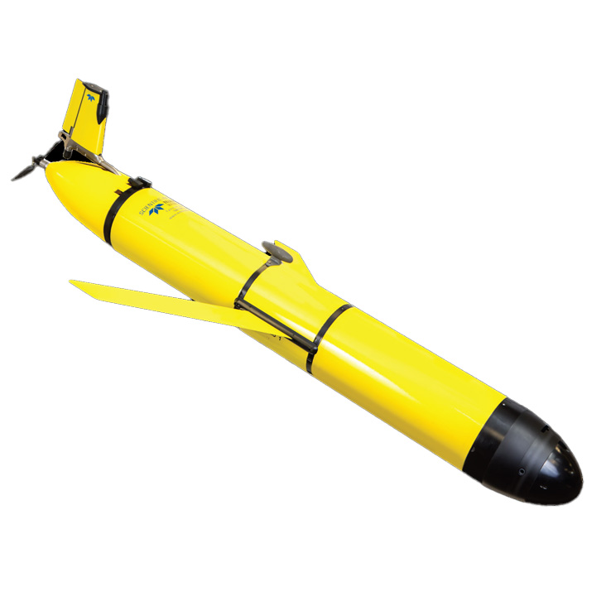
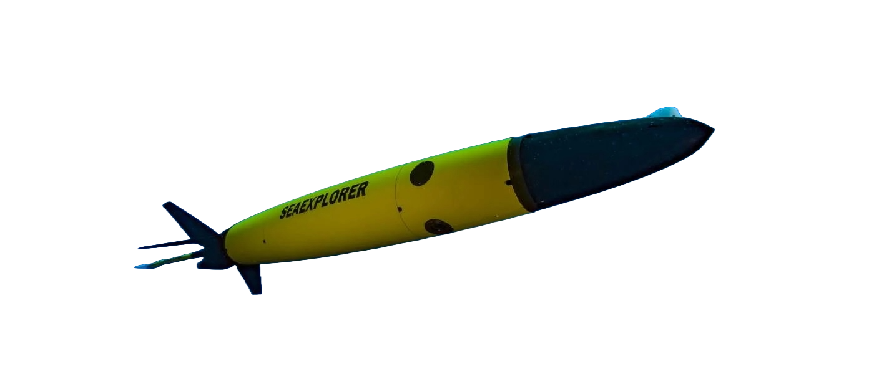
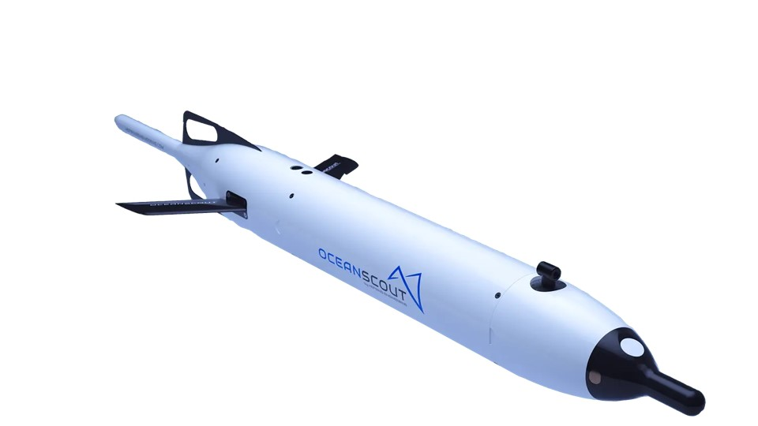
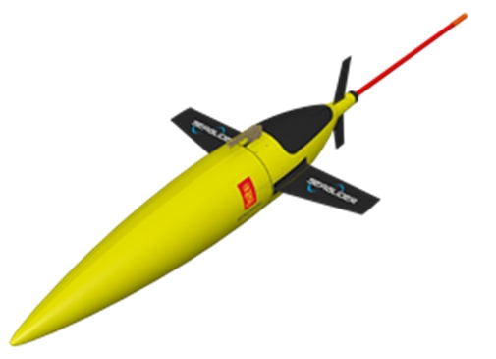
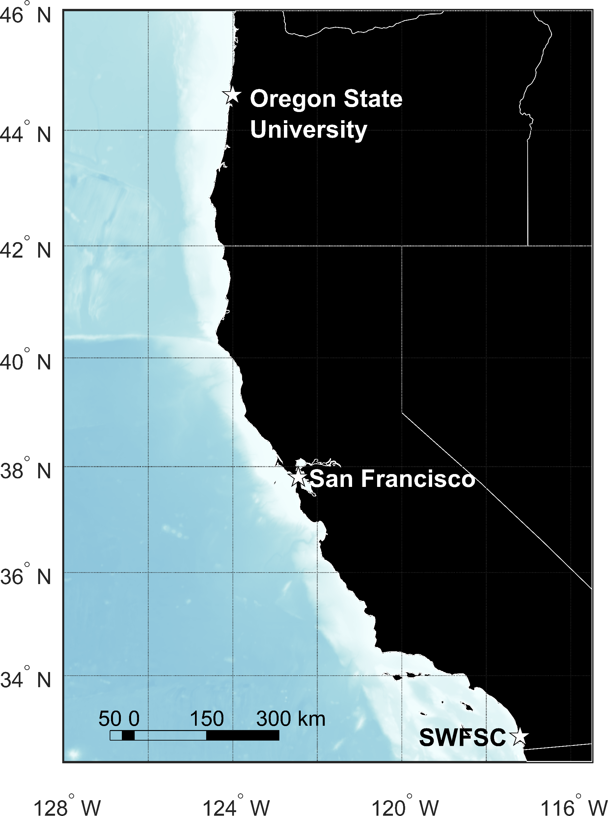
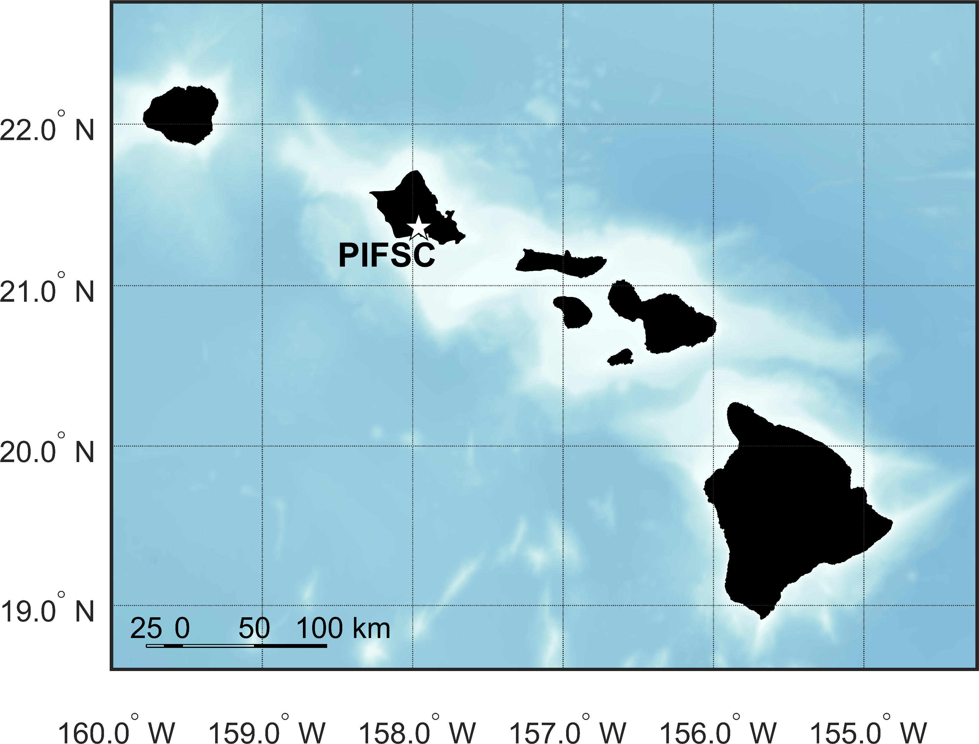



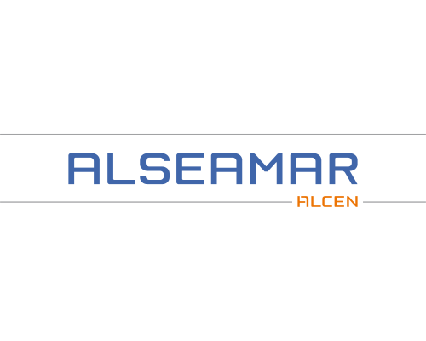
The PAM-Glider Rodeo
Passive Acoustic Monitoring (PAM) Glider Comparison
Erik Norris¹, Shannon Rankin², Erin Oleson¹, Christian Reiss², Selene Fregosi³, David K. Mellinger⁴
Testing 4 different gliders:
Seaglider
Slocum
SeaExplorer
OceanScout
Come fly with us!
Talk to us if you want to:
Field test PAM gliders
Field test other PAM systems
Analyze rodeo data
Discuss metrics to consider and compare
Anticipated dates: two weeks each in late 2025 to mid 2026
Testing 3 integrated PAM systems:
DMON
WISPR
Alseamar Acoustic Acquisition System
MAP OF CALIFORNIA
West Coast Rodeo
US West Coast
Hawaii Rodeo
Main Hawaiian
Islands
For more info visit:
https://nmfs-pam-glider.github.io/GliderRodeo
Participants:
Southwest Fisheries Science Center (SWFSC)
Pacific Islands Fisheries Science Center (PIFSC)
1 NOAA Fisheries, Pacific Islands Fisheries Science Center
2 NOAA Fisheries, Southwest Fisheries Science Center
3 Ocean Associates, Inc. contracted to NOAA PIFSC
4 Cooperative Institute for Marine Ecosystem and Resources Studies, Oregon State University and NOAA Pacific Marine Environmental Laboratory

